Slide 1


Fundamental Concepts
Math 14
Plane and Solid Analytic Geometry

Slide 2
OBJECTIVES:
At the end of the lesson, the student is expected to be able to:
• use the Cartesian Coordinate System efficiently and effectively as a tool in the study of Analytic Geometry.
• determine the distance between two points.
• use the coordinates of the vertices of a polygon to determine its area.

Slide 3
FUNDAMENTAL CONCEPTS
DEFINITION:
Analytic Geometry – is the branch of mathematics, which deals with the properties, behaviours, and solution of points, lines, curves, angles, surfaces and solids by means of algebraic methods in relation to a coordinate system.
Two Parts of Analytic Geometry
Plane Analytic Geometry – deals with figures on a plane surface.
Solid Analytic Geometry – deals with solid figures.

Slide 4
DEFINITION:
Directed Line – a line in which one direction is chosen as positive and the opposite direction as negative.
Directed Line Segment – consisting of any two points and the part between them.
Directed Distance – the distance between two points either positive or negative depending upon the direction of the line.

Slide 5

Coordinate Plane – is a plane determined by the coordinate axes.
Key Words: coordinates, abscissa, ordinate
RECTANGULAR COORDINATE SYSTEM
y
P (x, y)
x
o

Slide 6
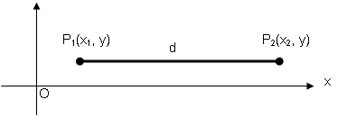
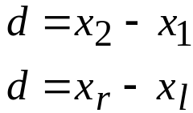
DISTANCE BETWEEN TWO POINTS
1. Horizontal Distance
The length of a horizontal line segment is the difference of the abscissas (x-coordinates) of the right endpoint and the left endpoint of the line segment. That is,
Distance,

Slide 7
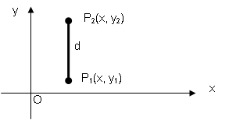
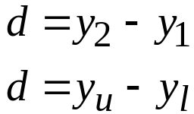
Vertical
The length of a vertical line segment is the difference in the ordinates (y-coordinates) of the upper endpoint and the lower endpoint of the line segment. That is,
Distance,

Slide 8
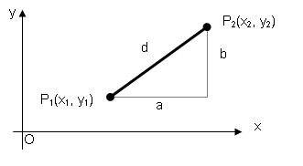
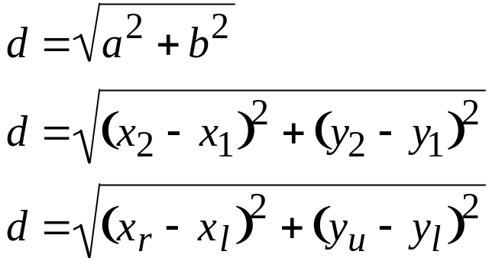
3. Slant
The distance between two points on a slant line segment is the square root of the sum of the squares of the difference of the abscissas and the difference of the ordinates. That is,
Distance ,

Slide 9
SAMPLE PROBLEMS
1. Determine the distance between
a. (-2, 3) and (5, 1)
b. (6, -1) and (-4, -3)
2. Show that points A (3, 8), B (-11, 3) and C (-8, -2) are vertices of an isosceles triangle.
Show that the triangle A (1, 4), B (10, 6) and C (2, 2) is a right triangle.
Find the point on the y-axis which is equidistant from A(-5, -2) and B(3,2).

Slide 10
5. By addition of line segments show whether the points A(-3, 0), B(-1, -1) and C(5, -4) lie on a straight line.
6. The vertices of the base of an isosceles triangle are (1, 2) and (4, -1). Find the ordinate of the third vertex if its abscissa is 6.
7. Find the radius of a circle with center at (4, 1), if a chord of length 4 is bisected at (7, 4).
Show that the points A(-2, 6), B(5, 3), C(-1, -11) and D(-8, -8) are the vertices of a rectangle.
The ordinate of a point P is twice the abscissa. This point is equidistant from (-3, 1) and (8, -2). Find the coordinates of P.
10. Find the point on the y-axis that is equidistant from (6, 1) and (-2, -3).

Slide 11

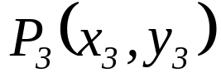

AREA OF A POLYGON BY COORDINATES
Consider the triangle whose vertices are P₁(x₁, y₁), P₂(x₂, y₂) and P₃(x₃, y₃) as shown below.
y
o
x

Slide 12
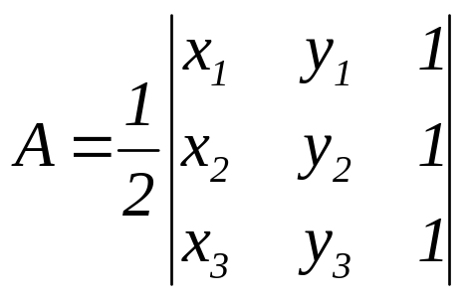
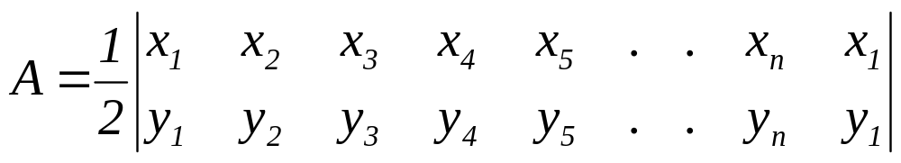
When the vertices of the triangle are labeled in the counterclockwise direction, then the area of the triangle is determined by:
Generalized formula for the area of polygon by coordinates:

Slide 13
SAMPLE PROBLEMS
Find the area of the triangle whose vertices are (-6, -4),
(-1, 3) and (5, -3).
Find the area of a polygon whose vertices are (6, -3), (3, 4),
(-6, -2), (0, 5) and (-8, 1).
Find the area of a polygon whose vertices are (2, -3), (6, -5),
(-4, -2) and (4, 0).
Reference: Analytic Geometry by Riddle

